Slide 1
Garbage and Unsanitary Practices
Mobility - Roads, Footpaths and Infrastructure
Traffic and Road Safety
Total Complaints
3933
Second highest in terms of Complaints received
Total Complaints
Total Complaints
984
Resolution Rate
5183
Fourth highest in terms of Complaints received
50%
Highest in terms of Complaints received
Highest in terms of Resolution Rate
Resolution Rate
19%
Acceptance Rate
56%
Effective Resolution Rate
84%
Effective Resolution Rate
36%
Comments Per Complaint
Resolution Rate
30%
Second Lowest
1.84
Highest in terms of CPC
Ignorance Rate
33%
Effective Resolution Rate
55%
Highest Ignorance Rate

Slide 2
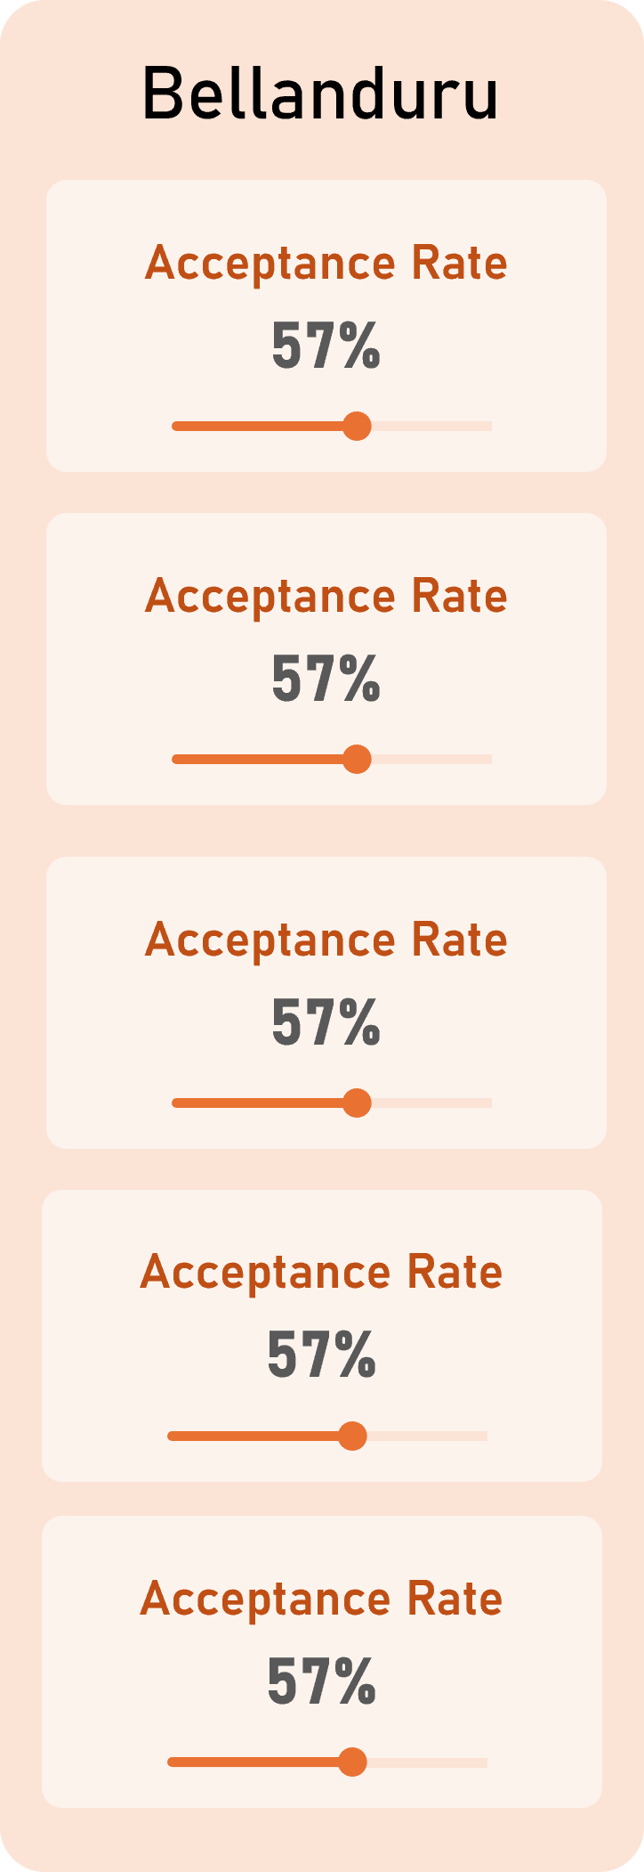
Parking-related complaints require appropriate verifiable evidence and are inherently time-sensitive. This may partly explain the comparatively higher ignorance rate.
Parking-related complaints require appropriate verifiable evidence and are inherently time-sensitive. This may partly explain the comparatively higher ignorance rate.
Parking-related complaints require appropriate verifiable evidence and are inherently time-sensitive. This may partly explain the comparatively higher ignorance rate.
A thorough review of complaint process could cause a city wide impact.
A thorough review of complaint process could cause a city wide impact.
A thorough review of complaint process could cause a city wide impact.
A thorough review of complaint process could cause a city wide impact.
A thorough review of complaint process could cause a city wide impact.
A thorough review of complaint process could cause a city wide impact.

Slide 3
Bellanduru
Hagadur
Best Overall Performance
Total Complaints
Acceptance Rate
Resolution Rate
Total Complaints
Acceptance Rate
Resolution Rate
727
57%
44%
237
44%
24%
Effective Resolution Rate
Comments Per Complaint
Effective Resolution Rate
Ignorance
Rate
77%
1.72
54%
3.0%
Horamavu
Total Complaints
Acceptance Rate
Resolution Rate
506
43%
26%
Effective Resolution Rate
Ignorance
Rate
60%
0%

Slide 4

Bellanduru
727
Best Overall Performance
Total complaints
Acceptance Rate
Resolution Rate
Resolution Rate
57%
44%
57%
Effective Resolution Rate
Comments Per Complaint
77%
1.72

